Slide 1


METORNESS
MARKET PRICE
PREDICTION
Ahmed Nasser
2024

Slide 2
1
intro
2
3
4
problem Description
5
6
In today's market analysis and forecasting, understanding the intricate patterns within time series data is essential for making informed decisions. With machine learning techniques, we can now delve deeper into historical market data to predict future trends accurately. Our dataset includes monthly market data spanning multiple years and covers various regions, commodities, and pricing information.
7
8
9

Slide 3



1
Object
2
3
Develop a robust time series machine learning model to forecast market trends based on historical data
4
5
Accurately predict future commodity quantities and prices to aid stakeholders in making proactive decisions on production, procurement, pricing, and resource allocation.
6
7
8
9

Slide 4



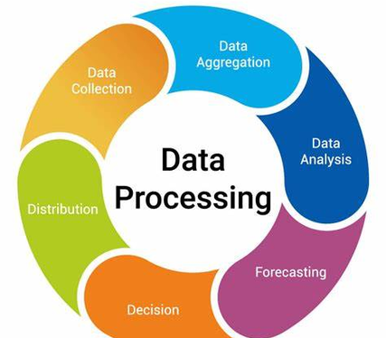
1
Data Preprocessing
2
3
4
Drop some columns
5
6
Resample the data to monthly frequency
7
8
9

Slide 5
1
2
Forecasting Price
3
4
Forecasting Quantity
5
6
7
8
9

Slide 6
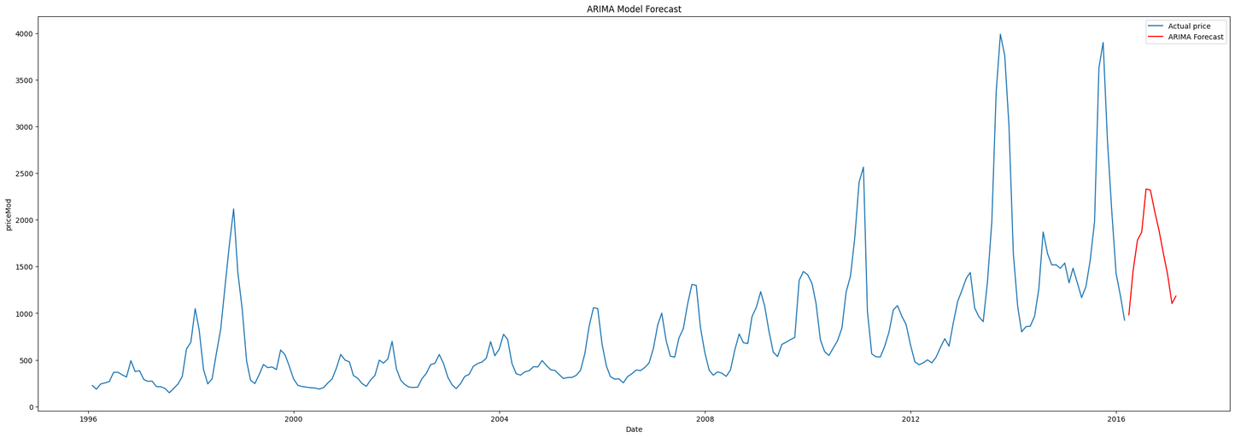
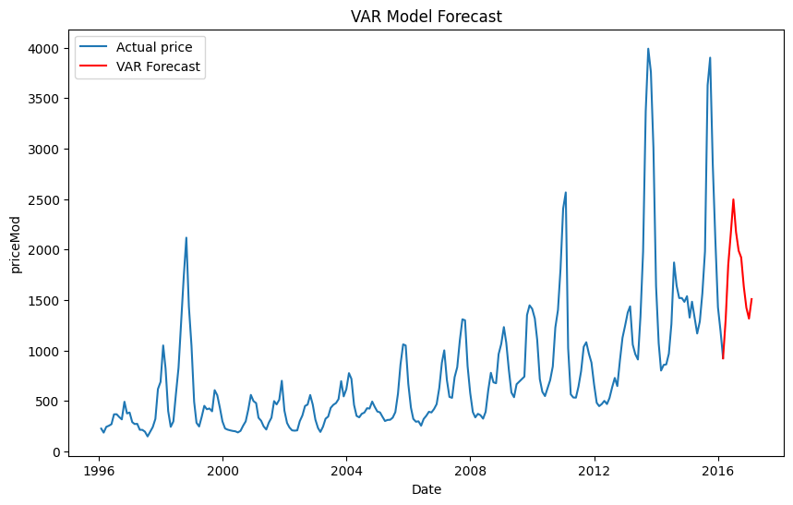
Forecasting Price
1
ARIMA
2
3
4
5
6
7
VAR
8
9

Slide 7
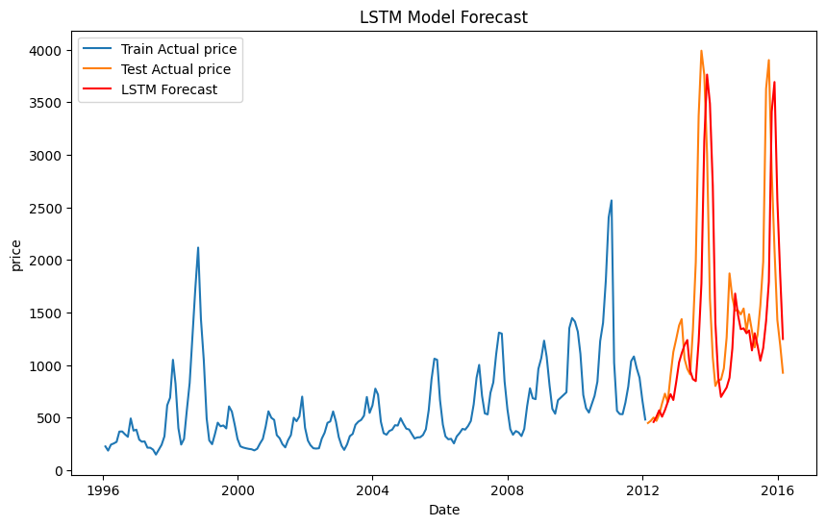

Forecasting Price
LSTM
1
2
3
4
5
6
7
ARIMA is the champion model.
8
9

Slide 8
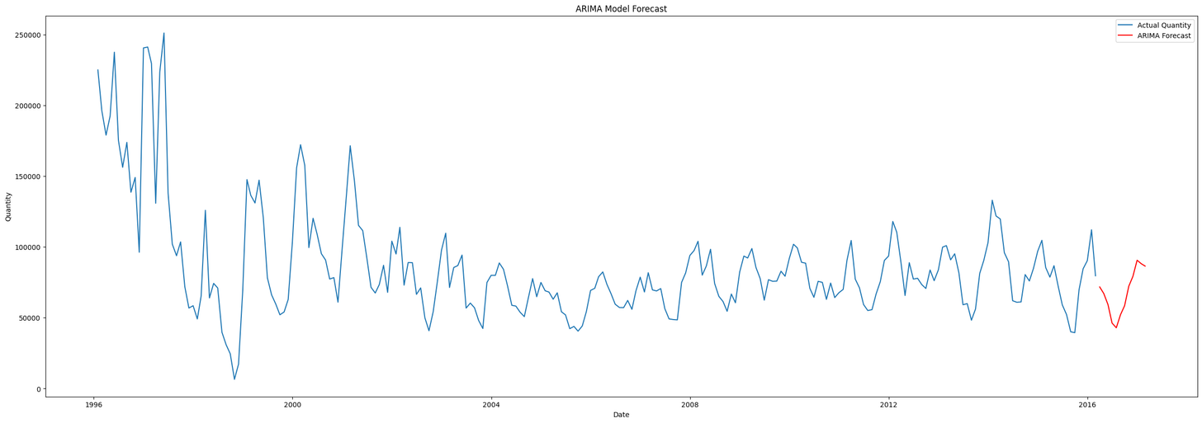
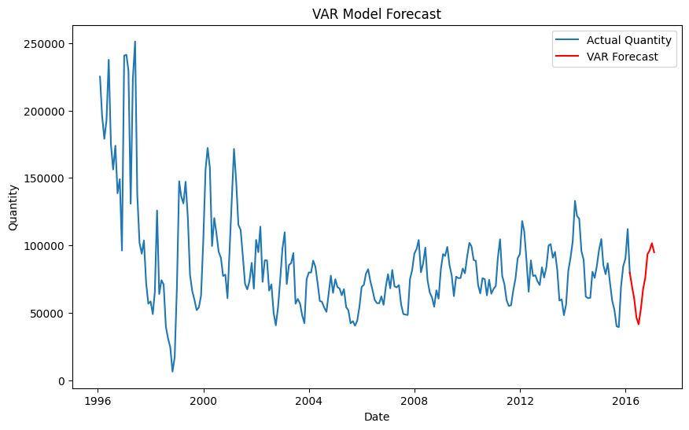
Forecasting Quantity
1
ARIMA
2
3
4
5
6
7
VAR
8
9

Slide 9
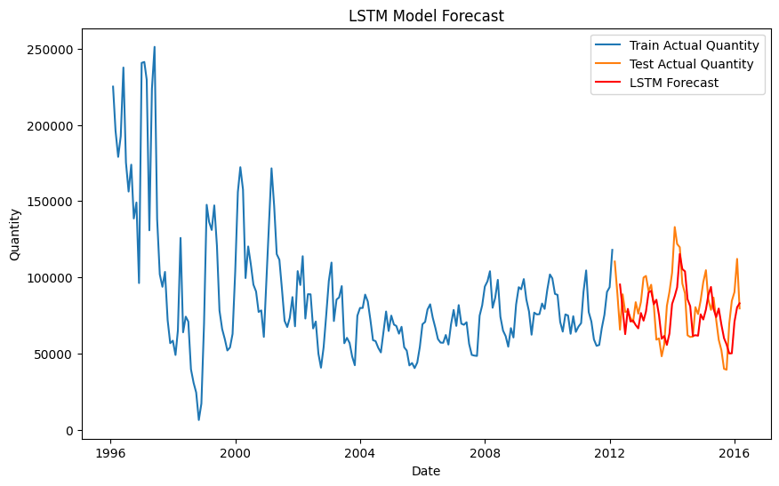

Forecasting Quantity
LSTM
1
2
3
4
5
6
7
8
ARIMA is The Champion Model.
9

Slide 10

1
2
3
4
5
Thank you
6
7
8
9

